Slide 1
AgriSense BW
PILOT: SOUTHERN DISTRICT, BOTSWANA
AI-powered smart agriculture for Botswana: crops, livestock and early warning
Eddie | Thapelo | Abel | Phillip | Eazy

Slide 2
The problem and our answer
The problem
AgriSense BW
What farmers get
Drought, animal disease and stock theft hit Botswana farmers hard.
One platform with two modules: crops and livestock.
Simple alerts in English and Setswana.
One early-warning engine joins them.
Risk levels: Low, Medium and High.
Warning signs are noticed too late.
AgriSense BW | 2

Slide 3
Data and pilot area
6
144
900
places in the Southern District: Kanye, Moshupa, Jwaneng, Good Hope, Mabutsane and Mmathethe
crop rows: 24 seasons across 6 places
livestock rows: 30 cattle tracked for 30 days
Weather, ndvi, yield and livestock values are sample data. Real FAO national yields (about 0.13 to 0.45 t/ha) were used to keep them realistic.
AgriSense BW | 3

Slide 4
Crop module
How it works
Result
Inputs: rainfall, temperature and ndvi (plant greenness).
2024 predictions are close to the sample values. Example, Kanye: 0.21 predicted, 0.198 actual.
A simple model predicts yield in tonnes per hectare.
This shows the pipeline works. It does not yet show accuracy on real farms.
Risk: below 70% of average is High, 70 to 90% is Medium, above 90% is Low.
AgriSense BW | 4

Slide 5
Livestock module
Rules
Results
Illness: body temperature 39.5 °C or higher with activity 40 or lower. Medium on day one, High from day two.
All 3 sick animals and the 1 wandering animal found from their first day.
Movement: far above the herd's normal daily distance. High at 3 km or more.
35 of 36 alerts are real problems. False alarms fell from 22 to 1.
The engine raises an outbreak warning for herd H2 (H2-04, H2-07, H2-09) on 23 September.
AgriSense BW | 5

Slide 6
The early-warning engine
Four rules
Delivery
Plain language: every reason is rewritten so a farmer can read it.
Advice in English and Setswana from one template file.
Merge repeats: the same problem on the same animal, day after day, becomes one alert.
SQLite database keeps alert statuses when the alerts are rebuilt.
Straying rule: unusual movement on 3 or more days in a row is High.
Dashboard with Alerts, Livestock and Crops tabs, and a map of flagged animals.
Outbreak rule: 3 or more possibly ill animals in one district within 7 days give a High warning for veterinary services.
Early-warning engine, database and dashboard by Phillip.
AgriSense BW | 6

Slide 7
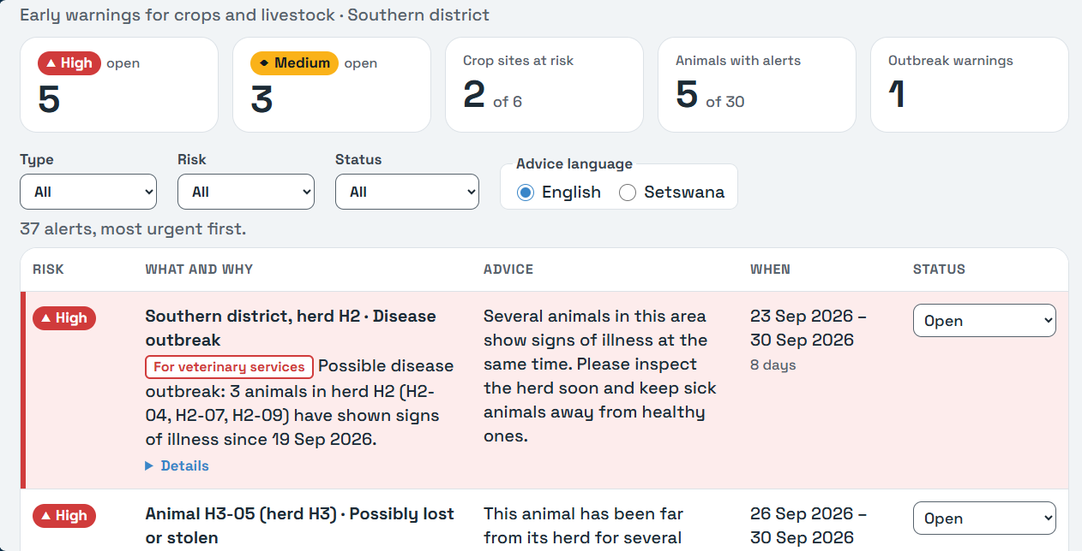
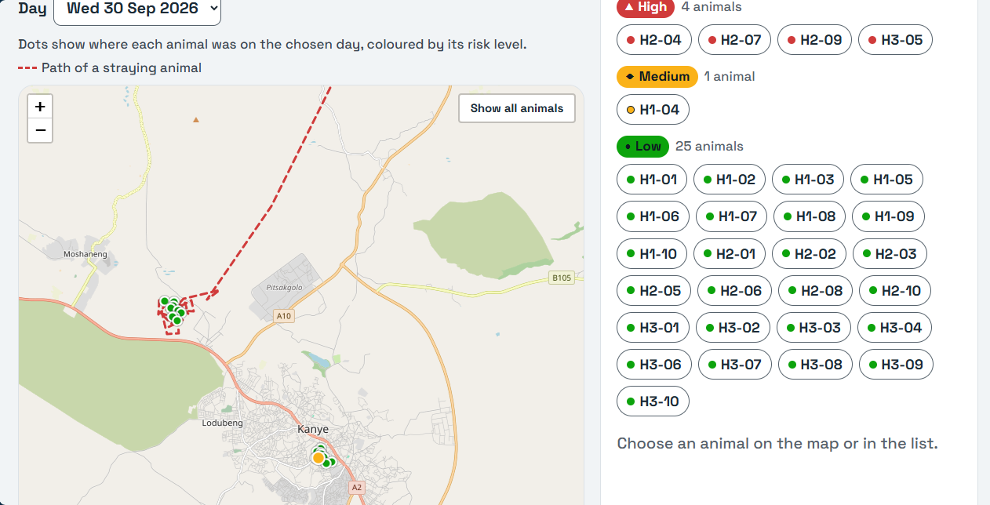
The dashboard
Alerts tab: the outbreak warning for herd H2 comes first, with advice in English or Setswana.
Livestock tab: map of the herds, with the dashed path of the straying animal H3-05.
AgriSense BW | 7 | Sample data, built by Phillip

Slide 8
Limits and next steps
Limits
Next steps
Weather, ndvi, yield and livestock data are sample data.
Several GPS fixes per day.
Real weather and NDVI data (NASA POWER, CHIRPS) and satellite imagery.
One GPS fix per day, so movement at night cannot be seen.
Disease detection from leaf photos.
The outbreak warning is only as good as the livestock detection.
PostgreSQL and accounts for farmers and vets.
Some Setswana advice texts still need a native speaker.
Alerts still need checking by a farmer or a vet.
AgriSense BW | 8

